Slide 1
IGNIS: Status Update
Alex Culbert, David Faulkenberry, Jason Fischell, Greg Goldman

Slide 2
Summary
Pugh Matrix to Decide General Approach
Interviews with Experts
Research and Analysis
Feasibility of Hydrogen Production
Waste Process - “Patient” Flow Chart
Functional Block Diagram
Rework Objectives
Prototyping Plan
Begin CAD Model

Slide 3
Interviews:
Luis Gene: Laboratorio Microtec, Sterilization Expert
Use French standard for testing: NF X30-503: 2016
Offered future support
Jose Castro Nieto: Ad Astra Rocket Company, Plasma Expert
Plasma waste treatment suggested in past, government was hesitant to invest
New president of Costa Rica has placed big focus on zero-emission economy
Proposed hydrogen incineration
Offered testing facilities

Slide 4
Pugh Matrix
Low Risk of Injury |  | Fuel Source Availability/Cost |  | Clean Emissions |  | Any Type of Waste |  | Build Material Available |  | Reduces Waste Mass |  | Totals
Score | Weight | Score | Weight | Score | Weight | Score | Weight | Score | Weight | Score | Weight
2 | 5 | 4 | 4 | 3 | 3 | 4 | 2 | 2 | 1 | 4 | 1 | 49
4 | 5 | 4 | 4 | 4 | 3 | 1 | 2 | 3 | 1 | 1 | 1 | 54
3 | 5 | 3 | 4 | 1 | 3 | 4 | 2 | 3 | 1 | 3 | 1 | 44
2 | 5 | 1 | 4 | 3 | 3 | 4 | 2 | 3 | 1 | 3 | 1 | 37
Plasma Pyrolysis
Inductive Heating
Trad. Incineration
H₂ Incineration

Slide 5
Justifications - Low Risk of Injury
Weight: 5 - Very important for obvious reasons. While all solutions will be designed with safety in mind, certain methods have greater or lesser associate risks/require more safety precautions.
Plasma Score: 2 - Reaches extremely high temperatures, requires high voltages, and may generate dangerous or unpredictable volatiles/byproducts
Inductive Score: 4 - While this will require relatively high voltages and current, it is less than Plasma, and as combustion will be limit there is a decreased risk of explosion
Traditional Score: 3 - With sustained combustion of fossil fuels, there is a high risk of explosion
Hydrogen Score: 2 - Hydrogen is more volatile than most fossil fuels and must be pressurized, increasing risk factor

Slide 6
Justifications - Fuel Source Availability/Cost
Weight: 4 - The availability of the fuel source, and the cost to produce/obtain it is essential for the operation of the device, and plays a major role in determining the operating cost
Plasma Score: 4 - Runs on electricity which, although it may be unreliable, will not need to run for extended periods of time, and is very inexpensive
Inductive Score: 4 - Runs on electricity which, although it may be unreliable, will not need to run for extended periods of time, and is very inexpensive
Traditional Score: 3 - Fossil fuels are readily available but more expensive than electricity, and must be transported to the site rather than being available
Hydrogen Score: 1 - Hydrogen is much harder to obtain and more expensive than an energetically equivalent quantity of fossil fuels

Slide 7
Justifications - Clean Emissions
Weight: 3 - Costa Rica is pushing to go completely carbon free in the immediate future. Further, minimizing environmental impact was one of the original goals for this project.
Plasma Score: 3 - Vaporization should be slightly cleaner than traditional combustion, and plasma does not rely on combustion of fossil fuels
Inductive Score: 4 - Runs on clean electricity and does minimizes combustion, virtually eliminating gaseous emissions
Traditional Score: 1 - Fossil fuels have high carbon emissions, and combustion produces gaseous emissions
Hydrogen Score: 3 - Hydrogen eliminates carbon emissions, but there is environmental impact associated with generating the hydrogen, and combustion still produces gaseous emissions

Slide 8
Justifications - Any Type of Waste
Weight: 2 - The ability to treat any necessary waste is helpful, but not essential. As long as the device can treat tissues, other waste, such as chemicals, can be treated through other means.
Plasma Score: 4 - Vaporization can treat both solid and liquid waste by breaking chemical bonds, eliminating biohazards and chemical hazards.
Inductive Score: 1 - Heat treatment can treat solid waste, but cannot be applied to liquid waste. Heat neutralizes biohazards but not chemical hazards. Liquids would just evaporate.
Traditional Score: 4 - Combustion can treat both solid and liquid waste by breaking chemical bonds, eliminating biohazards and chemical hazards.
Hydrogen Score: 4 - Combustion can treat both solid and liquid waste by breaking chemical bonds, eliminating biohazards and chemical hazards.

Slide 9
Justifications - Building Materials Readily Available
Weight: 1 - The availability of building materials, and the cost to produce/obtain them is a consideration for the production of the device, but because it is a one time expense it is not of great importance
Plasma Score: 2 - A plasma generation source may not be readily available but could be ordered at relative expense
Inductive Score: 3 - Parts should be readily available, but high fidelity construction may be difficult to guarantee
Traditional Score: 3 - Parts should be readily available, but high fidelity construction may be difficult to guarantee
Hydrogen Score: 3 - Parts should be readily available, but high fidelity construction may be difficult to guarantee

Slide 10
Justifications - Reduces Waste Mass
Weight: 1 - Reducing waste mass facilitates ease of disposal, but is of relatively little importance as far as waste treatment is concerned
Plasma Score: 4 - Parts of the waste are vaporized, greatly reducing waste mass
Inductive Score: 1 - Waste is heated to high temperatures, but is not vaporized nor combusted, so waste mass should change very little.
Traditional Score: 3 - Mass waste is reduced through combustion and gaseous emissions
Hydrogen Score: 3 - Mass waste is reduced through combustion and gaseous emissions

Slide 11
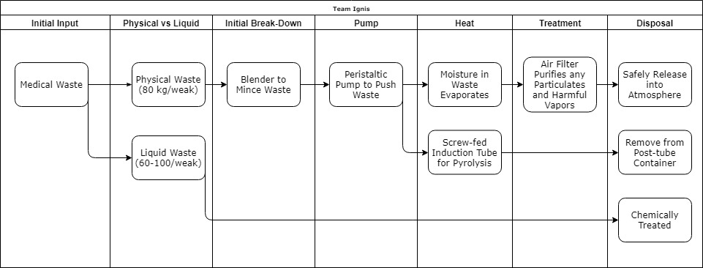
Waste Process

Slide 12
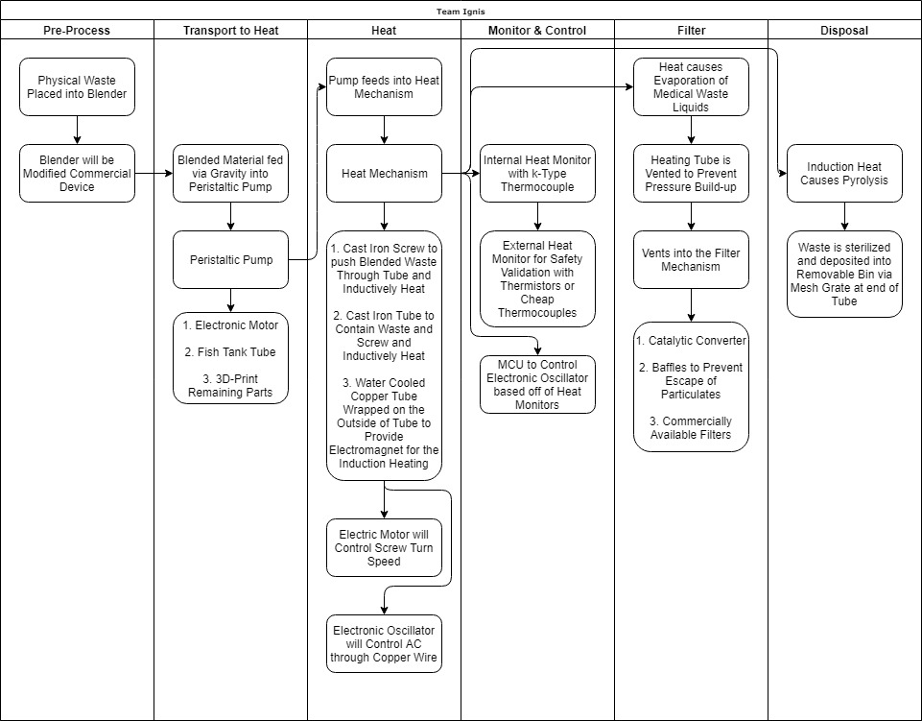
Functional Block Diagram

Slide 13
Reworking Objectives
Pugh Matrix and Justifications (250) - Generate a large, detailed, weighted, and justified Pugh Matrix to determine the best method of waste treatment between plasma pyrolysis, induction heating, traditional incineration, and hydrogen fueled incineration.
Functional Decomposition (250) - A functional decomposition (as described in class) of the entire waste treatment apparatus from pretreatment to disposal.
CAD Model of System (300) - A complete SolidWorks assembly of all of the essential components of the waste treatment system. Key components include the pretreatment blender, peristaltic pump, and induction heating chamber/feed mechanism.
Mechanical Scale Model (350) - Likely generated by 3D printing and assembling the components of the CAD Model, the mechanical scale model will demonstrate the efficacy of pumping waste through the system.

Slide 14
Reworking Objectives
Successful Generation of Heat (400) - Design and build a model inductive heating unit/chamber. This will be constructed from readily available parts and be used to prove the concept of inductive heating to generate heat, but extreme temperatures will not be expected.
Plan Control Method (200) - Design a feedback system that regulates the current flow through the heating coil based on the temperatures of the external casing, the heating element(s) and the waste itself.
Design User Interface (250) - Develop a plan to provide the user with information on the progress of the waste treatment and allow the user to adjust settings as needed. This process includes deciding what settings the user should be able to adjust and what information is necessary to provide.

Slide 15
Prototype Plan for End of Semester
Small scale inductive heater
Test temperature control system stability at low temperatures
Small scale model of feed mechanism using 3D prints and electric motors
Test grinding and feed mechanism using regular blender (beef or pork to mimic tissue waste)
Plan for user interface finished (possibly prototype using Arduino LCD Button Shield)
No need for purchases at this time

Slide 16
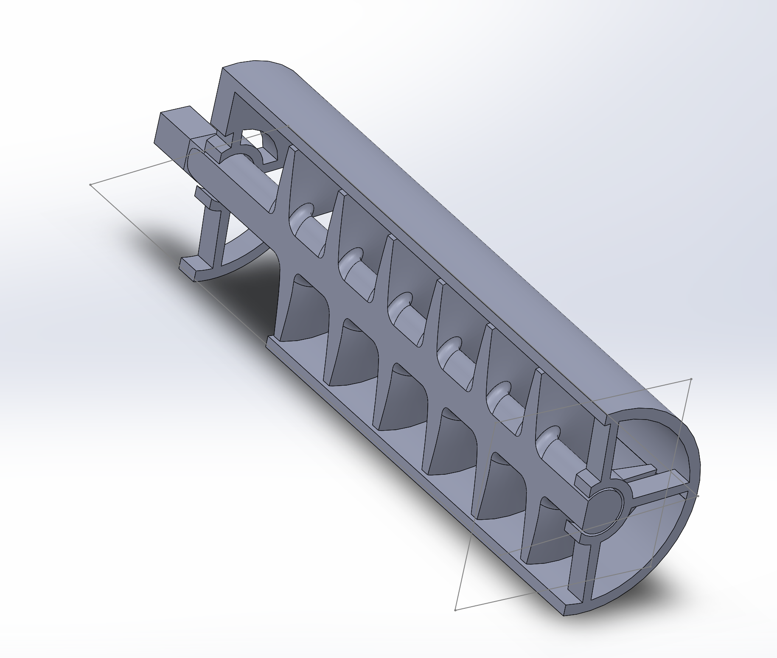
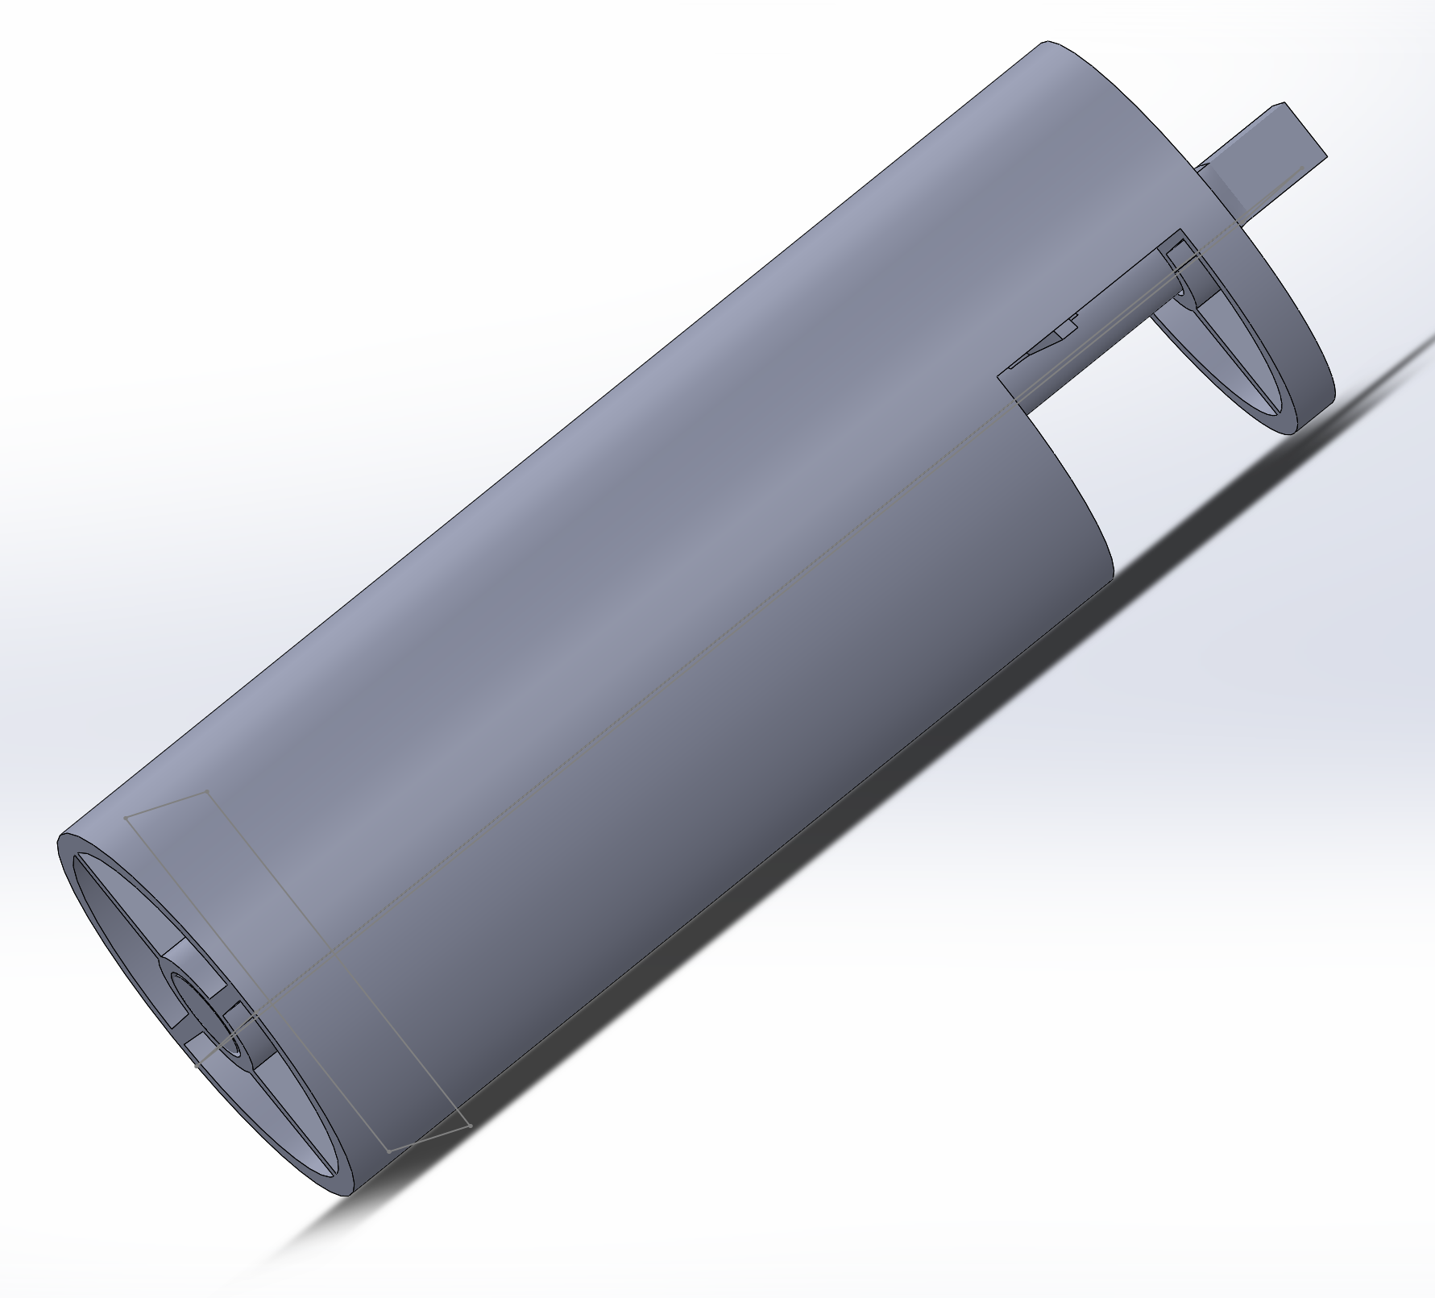
Feed and Heating Screw

Slide 17
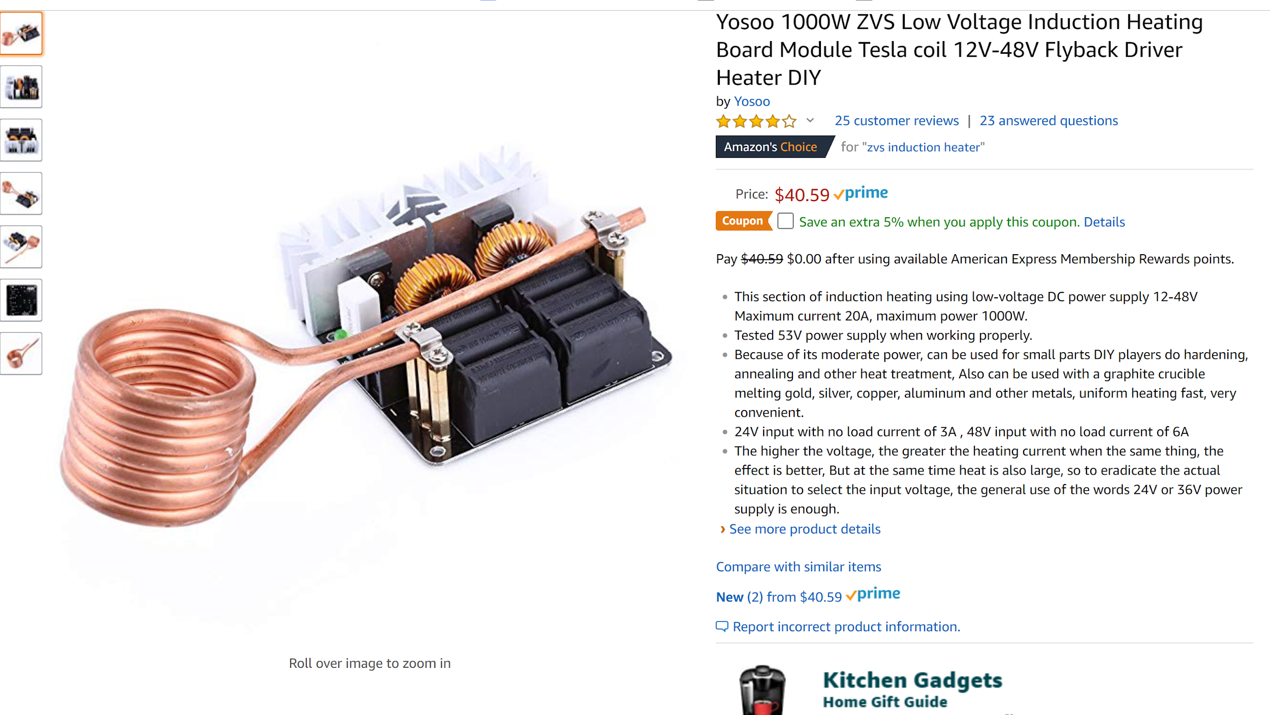
Device to test
https://www.amazon.com/GeekTeches-ZVS-Voltage-Induction-Heating/dp/B07DWV6Z12/ref=sr_1_9?s=hi&ie=UTF8&qid=1542679231&sr=1-9&keywords=induction+heater

